Slide 1
System Calls
§A.9 System Services
Programs do input/output through system calls
MIPS provides a special syscall instruction
To obtain services from the operating system
Many services are provided in the SPIM and MARS simulators
Using the syscall system services
Load the service number in register $v0
Load argument values, if any, in registers $a0, $a1, etc.
Issue the syscall instruction
Retrieve return values, if any, from result registers

Slide 2
Syscall Services
Service | $v0 | Arguments / Result
Print Integer | 1 | $a0 = integer value to print
Print Float | 2 | $f12 = float value to print
Print Double | 3 | $f12 = double value to print
Print String | 4 | $a0 = address of null-terminated string
Read Integer | 5 | Return integer value in $v0
Read Float | 6 | Return float value in $f0
Read Double | 7 | Return double value in $f0
Read String | 8 | $a0 = address of input buffer $a1 = maximum number of characters to read
Allocate Heap memory | 9 | $a0 = number of bytes to allocate Return address of allocated memory in $v0
Exit Program | 10

Slide 3
Syscall Services – Cont’d
Print Char | 11 | $a0 = character to print
Read Char | 12 | Return character read in $v0
Open File | 13 | $a0 = address of null-terminated filename string $a1 = flags (0 = read-only, 1 = write-only) $a2 = mode (ignored) Return file descriptor in $v0 (negative if error)
Read from File | 14 | $a0 = File descriptor $a1 = address of input buffer $a2 = maximum number of characters to read Return number of characters read in $v0
Write to File | 15 | $a0 = File descriptor $a1 = address of buffer $a2 = number of characters to write Return number of characters written in $v0
Close File | 16 | $a0 = File descriptor

Slide 4
Reading and Printing an Integer
################# Code segment #####################
.text
.globl main
main: # main program entry
li $v0, 5 # Read integer
syscall # $v0 = value read
move $a0, $v0 # $a0 = value to print
li $v0, 1 # Print integer
syscall
li $v0, 10 # Exit program
syscall

Slide 5
Reading and Printing a String
################# Data segment #####################
.data
str: .space 10 # array of 10 bytes
################# Code segment #####################
.text
.globl main
main: # main program entry
la $a0, str # $a0 = address of str
li $a1, 10 # $a1 = max string length
li $v0, 8 # read string
syscall
li $v0, 4 # Print string str
syscall
li $v0, 10 # Exit program
syscall

Slide 6
Program 1: Sum of Three Integers
# Sum of three integers
#
# Objective: Computes the sum of three integers.
# Input: Requests three numbers.
# Output: Outputs the sum.
################### Data segment ###################
.data
prompt: .asciiz "Please enter three numbers: \n"
sum_msg: .asciiz "The sum is: "
################### Code segment ###################
.text
.globl main
main:
la $a0,prompt # display prompt string
li $v0,4
syscall
li $v0,5 # read 1st integer into $t0
syscall
move $t0,$v0

Slide 7
Sum of Three Integers – Slide 2 of 2
li $v0,5 # read 2nd integer into $t1
syscall
move $t1,$v0
li $v0,5 # read 3rd integer into $t2
syscall
move $t2,$v0
addu $t0,$t0,$t1 # accumulate the sum
addu $t0,$t0,$t2
la $a0,sum_msg # write sum message
li $v0,4
syscall
move $a0,$t0 # output sum
li $v0,1
syscall
li $v0,10 # exit
syscall

Slide 8
Program 2: Case Conversion
# Objective: Convert lowercase letters to uppercase
# Input: Requests a character string from the user.
# Output: Prints the input string in uppercase.
################### Data segment #####################
.data
name_prompt: .asciiz "Please type your name: "
out_msg: .asciiz "Your name in capitals is: "
in_name: .space 31 # space for input string
################### Code segment #####################
.text
.globl main
main:
la $a0,name_prompt # print prompt string
li $v0,4
syscall
la $a0,in_name # read the input string
li $a1,31 # at most 30 chars + 1 null char
li $v0,8
syscall

Slide 9
Case Conversion – Slide 2 of 2
la $a0,out_msg # write output message
li $v0,4
syscall
la $t0,in_name
loop:
lb $t1,($t0)
beqz $t1,exit_loop # if NULL, we are done
blt $t1,'a',no_change
bgt $t1,'z',no_change
addiu $t1,$t1,-32 # convert to uppercase: 'A'-'a'=-32
sb $t1,($t0)
no_change:
addiu $t0,$t0,1 # increment pointer
j loop
exit_loop:
la $a0,in_name # output converted string
li $v0,4
syscall
li $v0,10 # exit
syscall

Slide 10
Example of File I/O
# Sample MIPS program that writes to a new text file
.data
file: .asciiz "out.txt" # output filename
buffer: .asciiz "Sample text to write"
.text
li $v0, 13 # system call to open a file for writing
la $a0, file # output file name
li $a1, 1 # Open for writing (flags 1 = write)
li $a2, 0 # mode is ignored
syscall # open a file (file descriptor returned in $v0)
move $s6, $v0 # save the file descriptor
li $v0, 15 # Write to file just opened
move $a0, $s6 # file descriptor
la $a1, buffer # address of buffer from which to write
li $a2, 20 # number of characters to write = 20
syscall # write to file
li $v0, 16 # system call to close file
move $a0, $s6 # file descriptor to close
syscall # close file

Slide 11
A.6 Procedures
A procedure (or function) is a tool used by programmers
Allows the programmer to focus on just one task at a time
Allows code to be reused
Procedure Call and Return
Put parameters in a place where procedure can access
Four argument registers: $a0 thru $a3 in which to pass parameters
Transfer control to the procedure and save return address
Jump-and-Link instruction: jal (Return Address saved in $ra)
Perform the desired task
Put results in a place where the calling procedure can access
Two value registers to return results: $v0 and $v1
Return to calling procedure: jr $ra (jump to return address)
§2.8 Supporting Procedures in Computer Hardware
§ A.6 Procedure Cal Convention

Slide 12
Instructions for Procedures
JAL (Jump-and-Link) used as the call instruction
Save return address in $ra and jump to procedure
Register $ra = $31 is used by JAL as the return address
JR (Jump Register) used to return from a procedure
Jump to instruction whose address is in register $ra (PC = $ra)
Instruction | Meaning | Format
jal label | $31=PC, jump | op⁶ = 3 | imm²⁶
jr $ra | PC = $Ra | op⁶ = 0 | rs⁵ | 0 | 0 | 0 | 8

Slide 13
Procedure Example
Consider the following swap procedure (written in C)
Translate this procedure to MIPS assembly language
void swap(int v[], int k)
{ int temp;
temp = v[k]
v[k] = v[k+1];
v[k+1] = temp;
}
swap:
sll $t0,$a1,2 # $t0=k*4
add $t0,$t0,$a0 # $t0=v+k*4
lw $t1,0($t0) # $t1=v[k]
lw $t2,4($t0) # $t2=v[k+1]
sw $t2,0($t0) # v[k]=$t2
sw $t1,4($t0) # v[k+1]=$t1
jr $ra # return
Parameters:
$a0 = Address of v[]
$a1 = k, and
Return address is in $ra

Slide 14
Call / Return Sequence
Suppose we call procedure swap as: swap(a,10)
Pass address of array a and 10 as arguments
Call the procedure swap saving return address in $31 = $ra
Execute procedure swap
Return control to the point of origin (return address)
swap:
sll $t0,$a1,2
add $t0,$t0,$a0
lw $t1,0($t0)
lw $t2,4($t0)
sw $t2,0($t0)
sw $t1,4($t0)
jr $ra
Registers
. . .
Caller
$a0=$4
addr a
la $a0, a
li $a1, 10
jal swap
# return here
. . .
$a1=$5
10
. . .
$ra=$31
ret addr

Slide 15
Details of JAL and JR
Address Instructions Assembly Language
00400020 lui $4, 0x1001 la $a0, a
00400024 ori $5, $0, 10 ori $a1,$0,10
00400028 jal 0x10000f jal swap
0040002C . . . # return here
swap:
0040003C sll $8, $5, 2 sll $t0,$a1,2
00400040 add $8, $8, $4 add $t0,$t0,$a0
00400044 lw $9, 0($8) lw $t1,0($t0)
00400048 lw $10,4($8) lw $t2,4($t0)
0040004C sw $10,0($8) sw $t2,0($t0)
00400050 sw $9, 4($8) sw $t1,4($t0)
00400054 jr $31 jr $ra
Pseudo-Direct
Addressing
PC = imm26<<2
0x10000f << 2
= 0x0040003C
$31
0x0040002C
Register $31
is the return address register

Slide 16
Procedure Call Convention
Procedure Call Convention, also called register use convention, is a software protocol governing the use of registers by procedures.
Name | Register | Usage | Comments
$zero | $0 | Always 0
$at | $1 | Reserved for assembler use | Should not be used by user programs or compilers.
$k0 – $k1 | $26–$27 | Reserved for OS kernel
$a0 – $a3 | $4–$7 | Arguments of a function | Used to pass the first four arguments to routines (remaining arguments are passed on the stack).
$v0 – $v1 | $2 – $3 | Result values of a function | Used to return values from functions.
$t0 – $t9 | $8–$15, $24, $25 | Caller-saved registers (caller pushes these registers onto the stack if it wants to restore this value after a procedure call.) | Used to hold temporary quantities that need not be preserved across calls.
$s0 – $s7 | $16 – $23 | Callee-saved registers (When the caller makes a procedure call, it can expect that those registers will hold the same value after the callee returns, making it the responsibility of the callee to save them and restore them before returning to the caller.) | Used to hold long-lived values that should be preserved across calls.
$gp | $28 | Global pointer | Point to the global static data
$sp | $29 | Stack pointer | Point to the last word of the frame (top of stack)
$fp | $30 | Frame pointer | Point to the first word of the frame. Used to quickly access values in its stack frame.
$ra | $31 | Return address | Used by jal for function call.

Slide 17
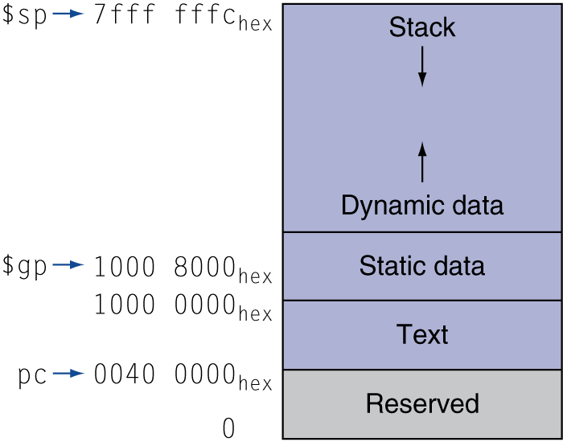
Memory Layout
Text: program code
Static data: global variables
e.g., static variables in C, constant arrays and strings
$gp initialized to address allowing ±offsets into this segment
Dynamic data: heap
E.g., malloc in C, new in Java
Stack: automatic storage

Slide 18
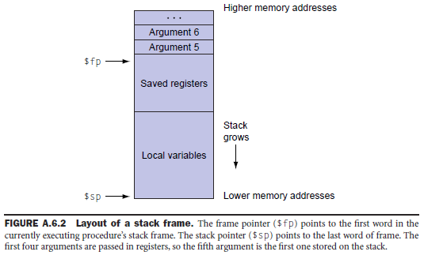
Stack Frames
Also called procedure call frame
A block of memory
To hold values passed to a procedure as arguments,
To save registers that a procedure may modify but that the procedure’s caller does not want changed
To provide space for variables local to a procedure.
Stack Frames:
Procedure calls and returns follow a strict last-in first-out (LIFO) order.
Memory can be allocated and deallocated on a stack.

Slide 19
Stack Frame
Stack frame is the segment of the stack containing …
Saved arguments, registers, and local data structures (if any)
Frames are pushed and popped by adjusting …
Stack pointer $sp = $29 and Frame pointer $fp = $30
Decrement $sp to allocate stack frame, and increment to free
Stack
Stack
Stack
. . .
$fp
$fp
argument 6
Frame f()
Frame f()
Frame f()
argument 5
f calls g
$sp
$sp
$fp
saved registers
↓
stack grows downwards
$fp
Frame g()
↑
free stack frame
g returns
$sp
local data structures
& variables
allocate stack frame
$sp

Slide 20
Procedure Calling Convention
The Caller should do the following:
Pass Arguments
First four arguments are passed in registers $a0 thru $a3
Additional arguments are pushed on the stack
Save Registers $a0 - $a3 and $t0 - $t9 if needed
Registers $a0 - $a3 and $t0 - $t9 should be saved by Caller
To preserve their value if needed after a procedure call
Called procedure is free to modify $a0 to $a3 and $t0 to $t9
Execute JAL Instruction
Jumps to the first instruction inside the procedure
Saves the return address in register $ra

Slide 21
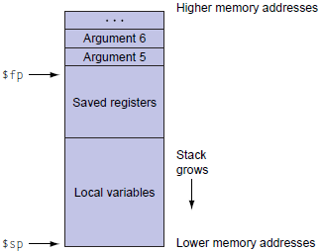
Procedure Calling Convention - 2
The Called procedure (Callee) should do the following to set up its stack frame:
Allocate memory for the stack frame
n bytes (frame size) are allocated on the stack frame
Save callee-saved registers in the stack frame
$ra, $fp, $s0 - $s7 should be saved inside procedure (callee)
Before modifying their value and only if needed
Register $ra should be saved only if the procedure makes a call
Update $sp and $fp (if needed)
$fp = $sp – 4
$sp = $sp – n

Slide 22
Procedure Return Convention
Just before returning, the called procedure should:
Place the returned results in $v0 and $v1 (if any)
Restore all registers that were saved upon entry
Load value of $ra, $fp, $s0 - $s7 if saved in the stack frame
Free the stack frame
$sp = $sp + n (if n bytes are allocated for the stack frame)
Return to caller
Jump to the return address: jr $ra

Slide 23
Leaf Procedure Example
Leaf procedure: not call others.
C code:
int leaf_example (int g, h, i, j) { int f; f = (g + h) - (i + j); return f; }
Arguments g, …, j in $a0, …, $a3
f in $s0 (hence, need to save $s0 on stack)
Result in $v0

Slide 24
Leaf Procedure Example
MIPS code: the parameter variables g, h, i and j are in argument registers $a0, $a1, $a2, and $a3 respectively.
addi $sp, $sp, -12 # adjust stack for 12 bytes stack frame
sw $t1, 8($sp) # save register $t1 for use afterwards
sw $t0, 4($sp) # save register $t0 for use afterwards
sw $s0, 0($sp) # save register $s0 for use afterwards
add $t0, $a0, $a1 # register $t0 contains g + h
add $t1, $a2, $a3 # register $t1 contains i + j
sub $s0, $t0, $t1 # register $s0 = (g + h) – (i + j)
add $v0, $s0, $zero # returns $v0 = $s0 + 0
lw $s0, 0($sp) # restore register $s0 for caller
lw $t0, 4($sp) # restore register $t0 for caller
lw $t1, 8($sp) # restore register $t1 for caller
addi $sp, $sp, 12 # adjust $sp to free stack frame
jr $ra # jump back to calling routine

Slide 25
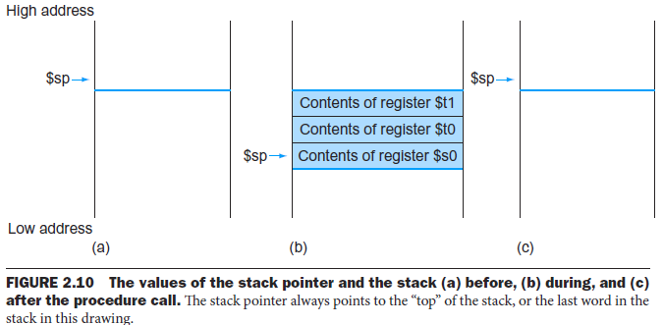
Leaf Procedure Example Cont’

Slide 26
Non-Leaf Procedures
Procedures that call other procedures
For nested call, caller needs to save on the stack:
Its return address
Any arguments and temporaries needed after the call
Restore from the stack after the call

Slide 27
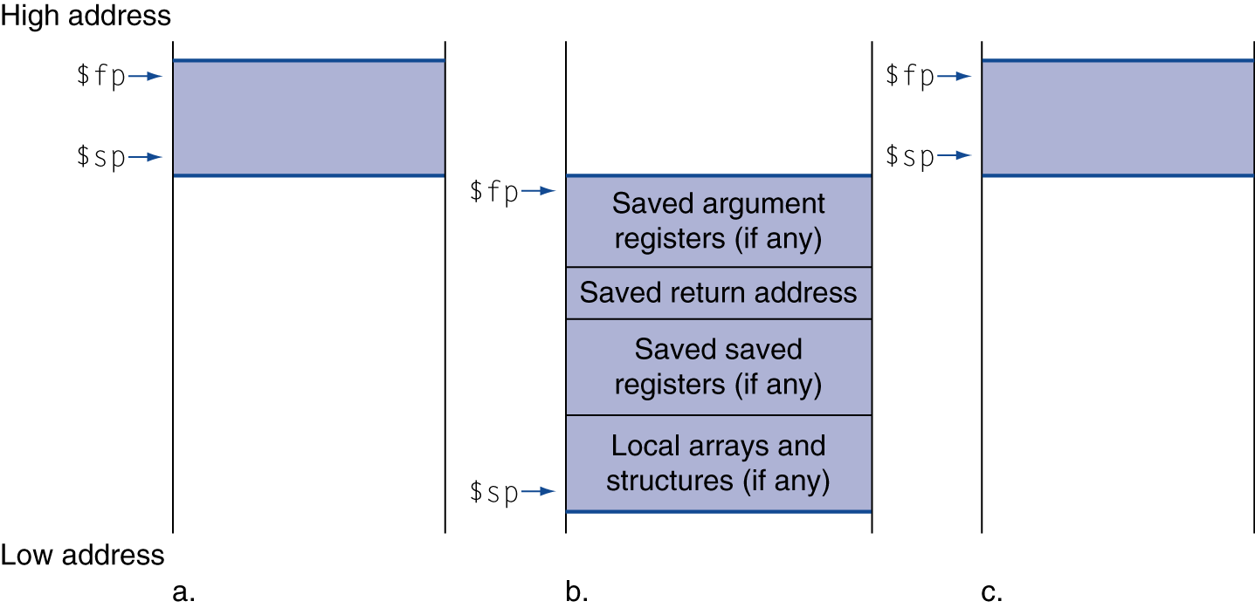
Local Data on the Stack
Local data allocated by callee
e.g., C automatic variables
Procedure frame (activation record)
Used by some compilers to manage stack storage

Slide 28
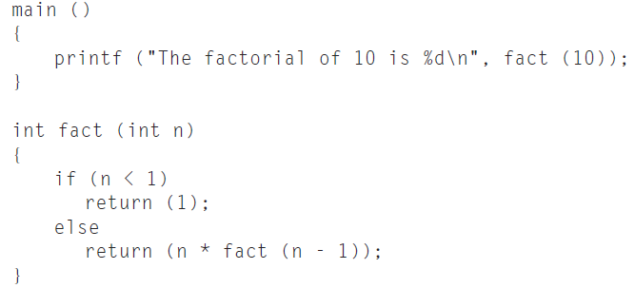
Recursive Procedure Call Example
Compute and print 10!.
fact is a recursive routine that computes n! by multiplying n with (n-1)!.

Slide 29
Non-Leaf Procedure Example
MIPS code:
fact: addi $sp, $sp, -8 # adjust stack for 2 items sw $ra, 4($sp) # save return address sw $a0, 0($sp) # save argument slti $t0, $a0, 1 # test for n < 1 beq $t0, $zero, L1 addi $v0, $zero, 1 # if so, result is 1 addi $sp, $sp, 8 # pop 2 items from stack jr $ra # and return L1: addi $a0, $a0, -1 # else decrement n jal fact # recursive call lw $a0, 0($sp) # restore original n lw $ra, 4($sp) # and return address addi $sp, $sp, 8 # pop 2 items from stack mul $v0, $a0, $v0 # multiply to get result jr $ra # and return

Slide 30
# Compute and factorial number of n (n!)
# Two functions: main and fact
.data
msg0: .asciiz "Please input parameter n: \n"
msg1: .asciiz "The factorial of \000"
msg2: .asciiz " is \000"
msg3: .ascii ".\n"
.text
.globl main
main:
# Register assignments
# $a0 = n
# input argument for parameter n
la $a0, msg0
li $v0, 4
syscall
li $v0, 5 # Read integer
syscall # $v0 = value read

Slide 31
# Passing parameter and call the procedure fact routine
move $s0, $v0 # Backup input argument in $s0
move $a0, $v0 # put argument in $a0
jal fact # call factorial function
# After fact returns, print the result returned from fact.
move $s1, $v0 # Backup fact return in $s1
la $a0, msg1
li $v0, 4
syscall
move $a0, $s0
li $v0, 1
syscall
la $a0, msg2
li $v0, 4
syscall
move $a0, $s1
li $v0, 1
syscall
la $a0, msg3
li $v0, 4
syscall
li $v0, 10 # exit
syscall

Slide 32
# Function fact (n)
.text
fact: addi $sp, $sp, -12 # Stack frame is 12 bytes long
sw $a0, 8($sp) # Save argument (n)
sw $ra, 4($sp) # Save return address
sw $fp, 0($sp) # Save frame pointer
addi $fp, $sp, 8 # Set up frame pointer
slti $t0, $a0, 1 # test for n < 1
beq $t0, $zero, L1
addi $v0, $zero, 1 # if so, result is 1
lw $fp, 0($sp) # Restore $fp
addi $sp, $sp, 12 # Pop Stack and return
jr $ra # Return to caller
L1: addi $a0, $a0, -1
jal fact
lw $a0, 8($sp) # Restore $ra
lw $ra, 4($sp) # Restore $ra
lw $fp, 0($sp) # Restore $fp
addi $sp, $sp, 12 # Pop Stack
mul $v0, $v0, $a0 # Compute fact (n-1) * n
jr $ra # Return to caller

Slide 33
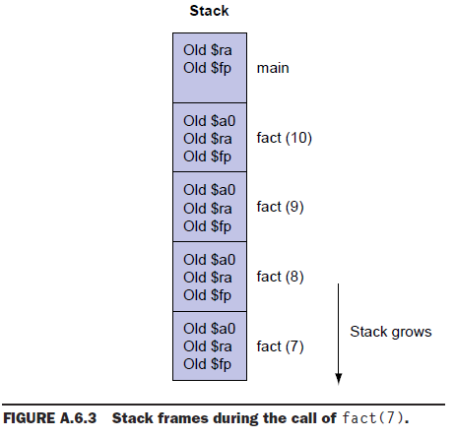
Stack in Recursive Procedure

